Slide 1
My Journey
Ziyan Yang
2+2: China Agricultural University (2009)
PhD: Agricultural and Resource Economics (2011)

Slide 2
Tianjin Foreign Languages School

Slide 3
China Agricultural University
Commencement 2011

Slide 4
First TWO Classes at UMD
Abhaya Mudra=No Fear
ARTH 290 (Art of Asia)
ENSP 101 (Environmental Science)

Slide 5
Married to a Chemist

Slide 6
Explore AGNR and CAU with No Fear
Science, 2010
2011: Undergrad Honor Thesis
2012: PhD First Year Qualifying Paper
2014: Met with the Research Group in CAU

Slide 7
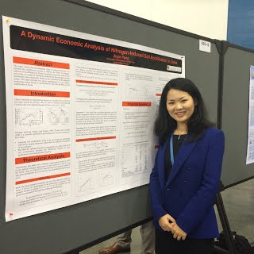
A Dynamic Economic Analysis of Nitrogen Induced Soil Acidification in China, AAAS Annual Meeting, 2015

Slide 8
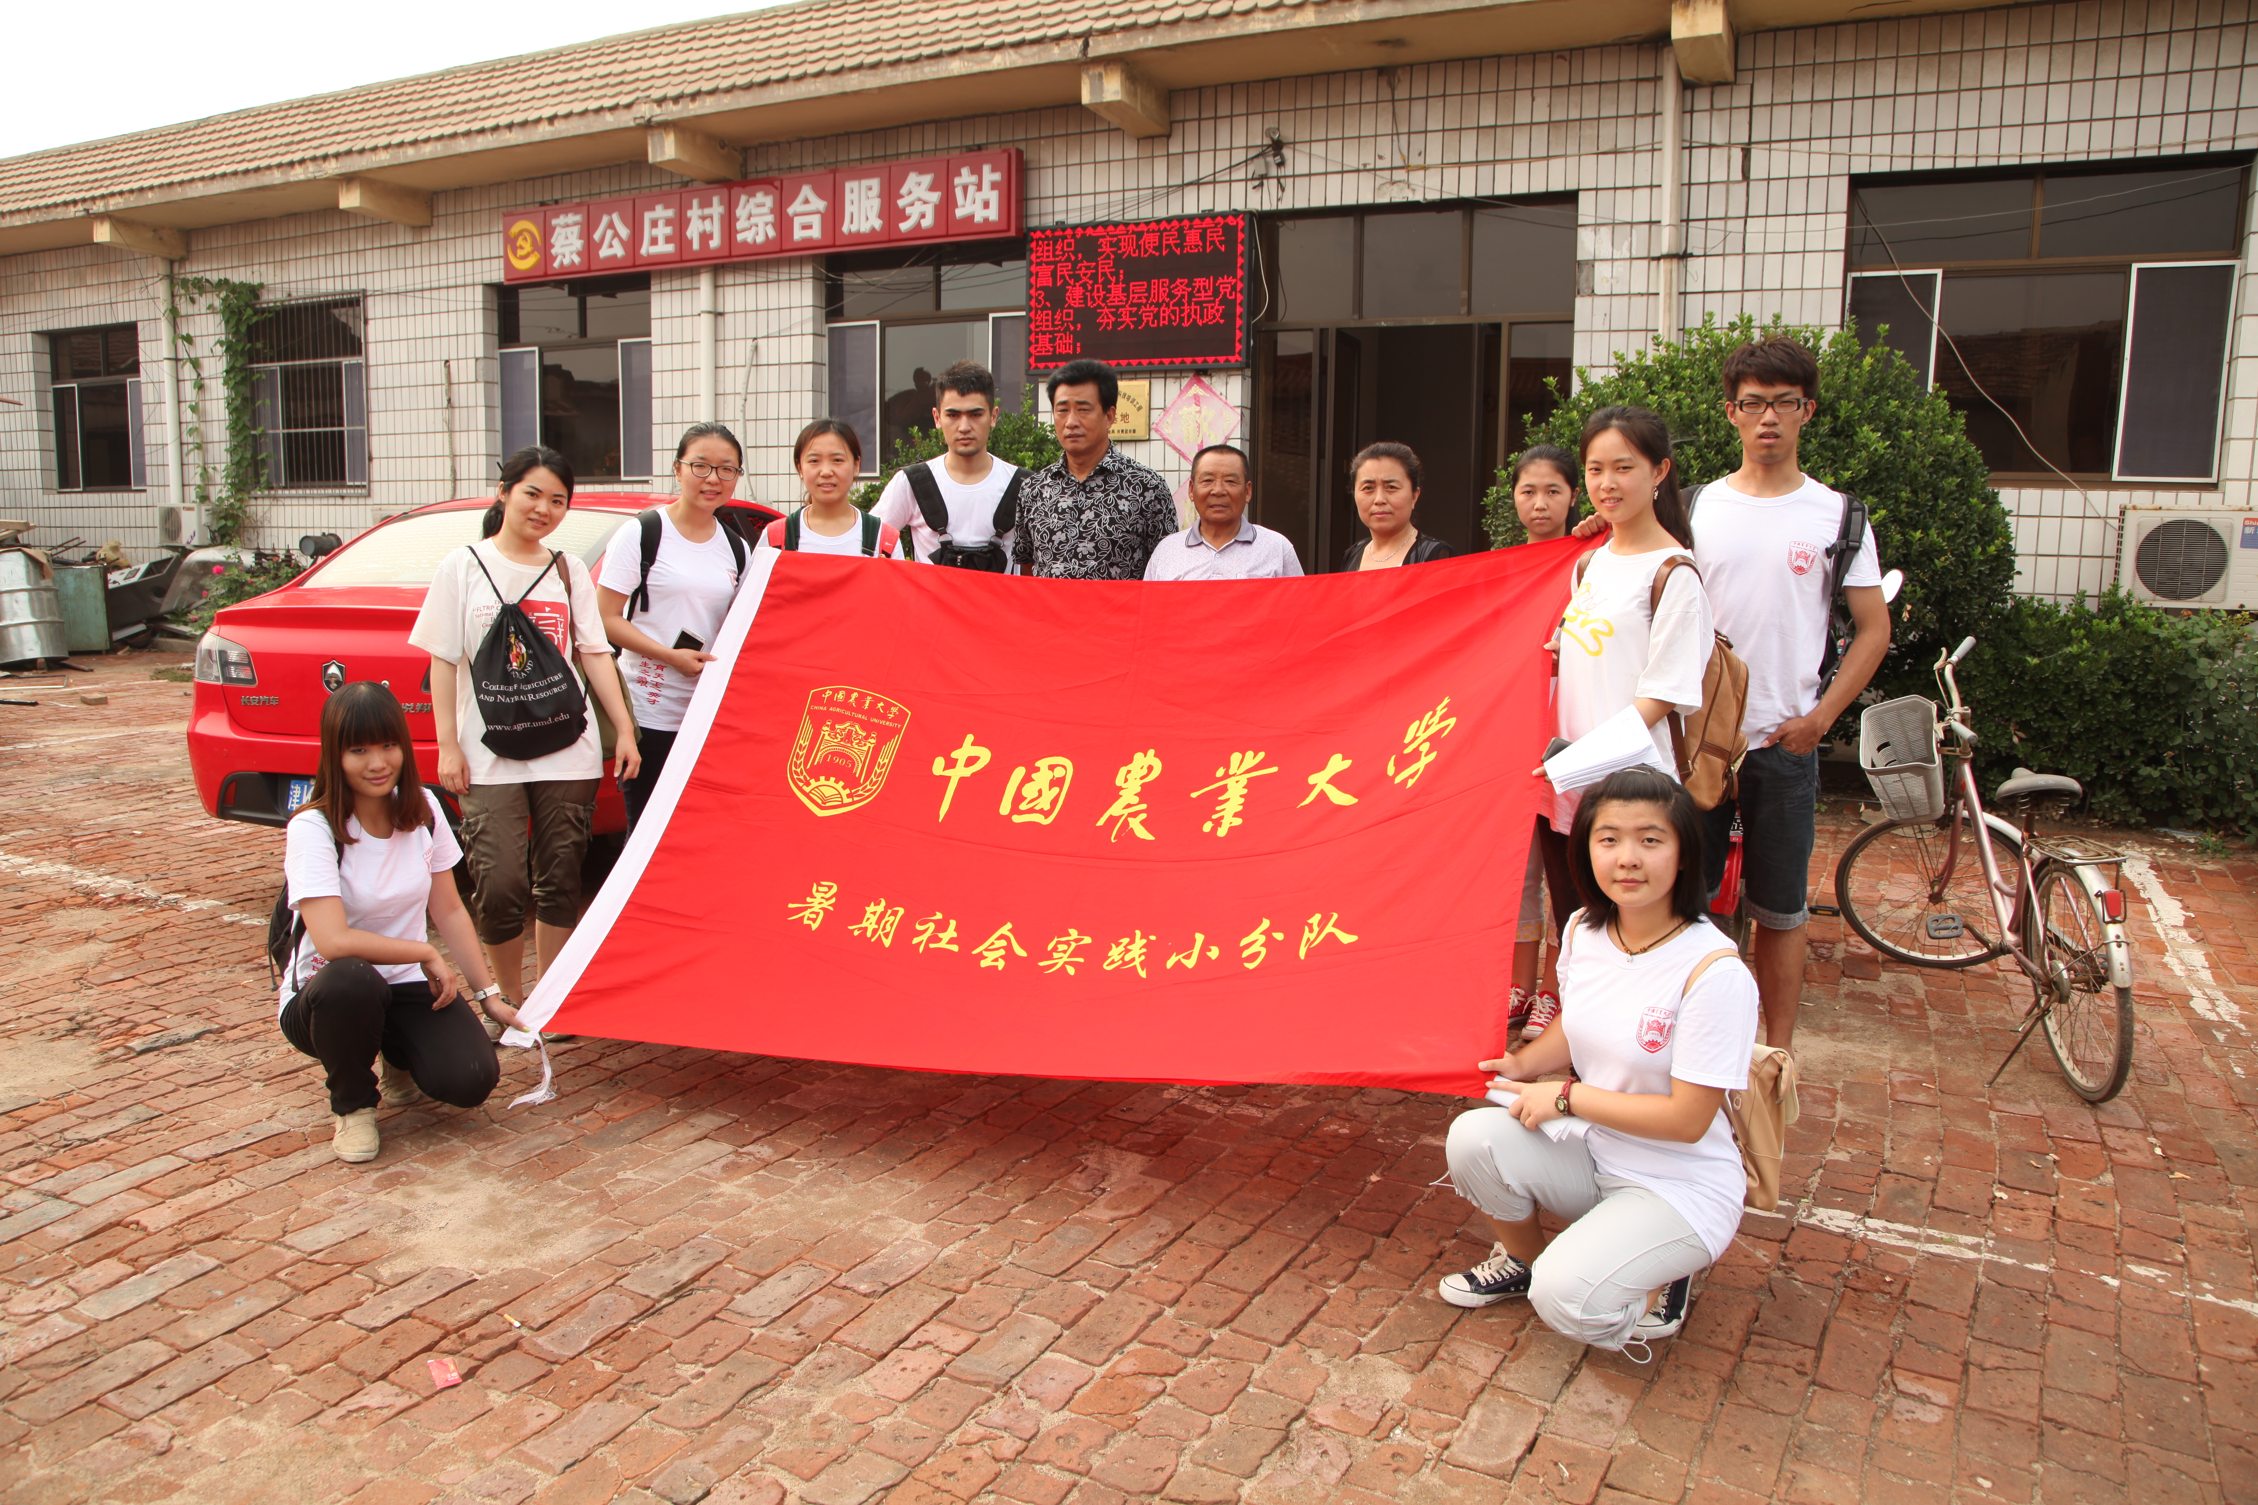
Survey with CAU undergrads (2014)

Slide 9
